Slide 1

Principles of Information Systems, Thirteenth Edition
Chapter 2
Information Systems in Organizations
Notes:
Principles of Information Systems, Thirteenth Edition
Chapter 2
Information Systems in Organizations

Slide 2
Objectives
After completing this chapter, you will be able to:
Sketch a general model of an organization showing how information systems support and work within automated portions of an organizational process
Define the term value chain and identify several examples within a typical manufacturing or service organization
Define the term innovation and identify two types
Define reengineering and continuous improvement and explain how they are different
Notes:
Objectives
After completing this chapter, you will be able to:
Sketch a general model of an organization showing how information systems support and work within automated portions of an organizational process
Define the term value chain and identify several examples within a typical manufacturing or service organization
Define the term innovation and identify two types
Define reengineering and continuous improvement and explain how they are different

Slide 3
Objectives
After completing this chapter, you will be able to:
Discuss pros and cons of outsourcing, offshoring, and downsizing
Define the term “the soft side of implementing change” and explain why it is a critical factor in the successful adoption of any major change
Identify and describe four change models used to increase the likelihood of successfully introducing a new IS into an organization
Define the types of roles, functions and careers available in the field of IS
Notes:
Objectives
After completing this chapter, you will be able to:
Discuss pros and cons of outsourcing, offshoring, and downsizing
Define the term “the soft side of implementing change” and explain why it is a critical factor in the successful adoption of any major change
Identify and describe four change models used to increase the likelihood of successfully introducing a new IS into an organization
Define the types of roles, functions and careers available in the field of IS

Slide 4
Organizations and Information Systems
Organization: a group of people that is structured and managed to meet its mission or set of group goals
There are relationships between members of the organization and their various activities
Processes are defined that assign roles, responsibilities, and authority to complete the various activities
Organizations are open systems
They affect and are affected by their surrounding environments
Notes:
Organizations and Information Systems
Organization: a group of people that is structured and managed to meet its mission or set of group goals
There are relationships between members of the organization and their various activities
Processes are defined that assign roles, responsibilities, and authority to complete the various activities
Organizations are open systems
They affect and are affected by their surrounding environments

Slide 5
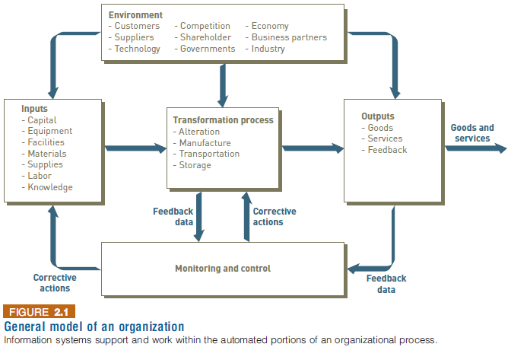
Organizations and Information Systems
Notes:
Organizations and Information Systems

Slide 6
Organizations and Information Systems
Value chain: a series (chain) of activities that an organization performs to transform inputs into outputs
The value of the input is increased
Supply chain: key value chain in a manufacturing organization
Supply chain management (SCM): encompasses all the activities required to get the right product into the right consumer’s hands in the right quantity at the right time and at the right cost
Notes:
Organizations and Information Systems
Value chain: a series (chain) of activities that an organization performs to transform inputs into outputs
The value of the input is increased
Supply chain: key value chain in a manufacturing organization
Supply chain management (SCM): encompasses all the activities required to get the right product into the right consumer’s hands in the right quantity at the right time and at the right cost

Slide 7
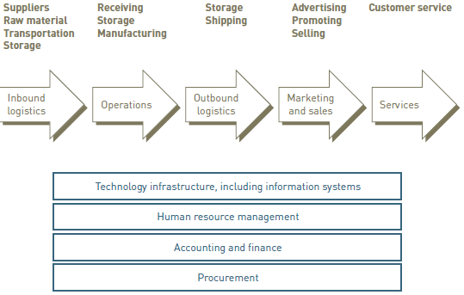
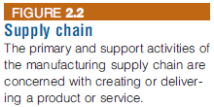
Organizations and Information Systems
Notes:
Organizations and Information Systems

Slide 8
Organizations and Information Systems
Supply chain organizations are “linked” together through both physical flows and information flows
Physical: supplies and raw materials
Information: participants communicating their plans, coordinating their work, and managing the efficient flow of goods and material
The information system can play an integral role in the supply chain process:
Providing input
Aiding product transformation
Producing output
Notes:
Organizations and Information Systems
Supply chain organizations are “linked” together through both physical flows and information flows
Physical: supplies and raw materials
Information: participants communicating their plans, coordinating their work, and managing the efficient flow of goods and material
The information system can play an integral role in the supply chain process:
Providing input
Aiding product transformation
Producing output

Slide 9
Virtual Teams and Collaborative Work
Virtual team: a group of individuals whose members are distributed geographically, but work as a coherent unit through the use of information systems technology
Strength: the best available people are enlisted to solve important organizational problems
Supported by electronic communications: email, instant messages, video conferences, etc.
Notes:
Virtual Teams and Collaborative Work
Virtual team: a group of individuals whose members are distributed geographically, but work as a coherent unit through the use of information systems technology
Strength: the best available people are enlisted to solve important organizational problems
Supported by electronic communications: email, instant messages, video conferences, etc.

Slide 10
Innovation
Innovation: the application of new ideas to the products, processes, and activities of a firm, leading to increased value
A catalyst for the growth and success of an organization
Can lead to cutting-edge products
New revenue streams
Increased profits
Types of innovation
Sustaining innovation: results in enhancements to existing products, services, and ways of operating
Enable an organization to continually increase profits, lower costs, and gain market share
Disruptive innovation: one that initially provides a lower level of performance than the marketplace has grown to accept
Improved to provide new performance characteristics
Notes:
Innovation
Innovation: the application of new ideas to the products, processes, and activities of a firm, leading to increased value
A catalyst for the growth and success of an organization
Can lead to cutting-edge products
New revenue streams
Increased profits
Types of innovation
Sustaining innovation: results in enhancements to existing products, services, and ways of operating
Enable an organization to continually increase profits, lower costs, and gain market share
Disruptive innovation: one that initially provides a lower level of performance than the marketplace has grown to accept
Improved to provide new performance characteristics

Slide 11
Reengineering and Continuous Improvement
Reengineering
Also called process redesign and business process reengineering (BPR)
Involves the radical redesign of business processes, organizational structures, information systems, and values of the organization to achieve a breakthrough in business results
Continuous improvement
Constantly seeking ways to improve business processes and add value to products and services
Notes:
Reengineering and Continuous Improvement
Reengineering
Also called process redesign and business process reengineering (BPR)
Involves the radical redesign of business processes, organizational structures, information systems, and values of the organization to achieve a breakthrough in business results
Continuous improvement
Constantly seeking ways to improve business processes and add value to products and services

Slide 12
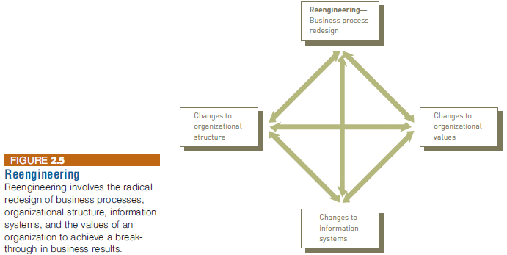
Reengineering and Continuous Improvement
Notes:
Reengineering and Continuous Improvement

Slide 13
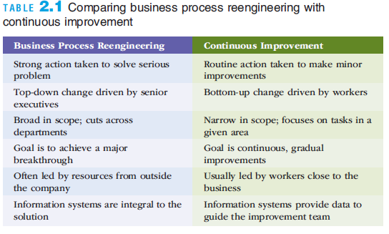
Reengineering and Continuous Improvement
Notes:
Reengineering and Continuous Improvement

Slide 14
Outsourcing, Offshoring, and Downsizing
Outsourcing
A long-term business arrangement in which a company contracts for services with an outside organization that has expertise in providing a specific function
Offshore outsourcing (offshoring)
The service is located in a country different than the firm obtaining the services
A number of companies are finding that outsourcing does not necessarily lead to reduced costs
Notes:
Outsourcing, Offshoring, and Downsizing
Outsourcing
A long-term business arrangement in which a company contracts for services with an outside organization that has expertise in providing a specific function
Offshore outsourcing (offshoring)
The service is located in a country different than the firm obtaining the services
A number of companies are finding that outsourcing does not necessarily lead to reduced costs

Slide 15
Outsourcing, Offshoring, and Downsizing
Downsizing
Reducing the number of employees to cut costs
Also referred to as “rightsizing”
Product quality and employee morale can suffer
Notes:
Outsourcing, Offshoring, and Downsizing
Downsizing
Reducing the number of employees to cut costs
Also referred to as “rightsizing”
Product quality and employee morale can suffer

Slide 16
Organizational Culture and Change
Culture: a set of major understandings and assumptions shared by a group
Organizational culture: the major understandings and assumptions for a business, corporation, or other organization
Organizational change: how organizations plan for, implement, and handle change
Soft side of implementing change: involves work designed to help employees embrace a new information system and way of working
Notes:
Organizational Culture and Change
Culture: a set of major understandings and assumptions shared by a group
Organizational culture: the major understandings and assumptions for a business, corporation, or other organization
Organizational change: how organizations plan for, implement, and handle change
Soft side of implementing change: involves work designed to help employees embrace a new information system and way of working

Slide 17
Organizational Culture and Change
Change management model
Describes the phases an individual or organization goes through in making a change
Provides principles for successful implementation of change
There are a number of models for dealing with the soft side of implementing change
Notes:
Organizational Culture and Change
Change management model
Describes the phases an individual or organization goes through in making a change
Provides principles for successful implementation of change
There are a number of models for dealing with the soft side of implementing change

Slide 18
Lewin’s Change Model
Lewin’s change model consists of a three-stage approach for change
Unfreezing: preparing for change
Moving: making the change
Refreezing: institutionalizing
Notes:
Lewin’s Change Model
Lewin’s change model consists of a three-stage approach for change
Unfreezing: preparing for change
Moving: making the change
Refreezing: institutionalizing

Slide 19
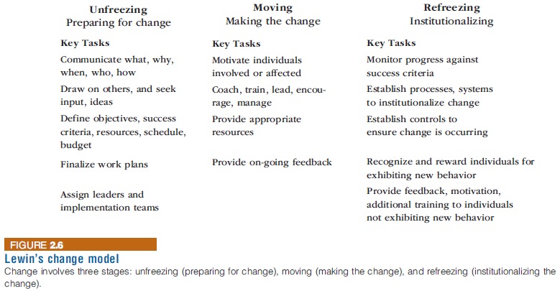
Lewin’s Change Model
Lewin’s change model consists of a three-stage approach for change
Unfreezing: preparing for change
Moving: making the change
Refreezing: institutionalizing
Notes:
Lewin’s Change Model

Slide 20
Lewin’s Force Field Analysis
Lewin extended his change model theory to include force field analysis
Identifies both the driving (positive) and restraining (negative) forces that influence whether change can occur
Driving forces: beliefs, expectations, and cultural norms that tend to encourage a change and give it momentum
Restraining forces: those that make it difficult to accept a change or to work to implement a change
Notes:
Lewin’s Force Field Analysis
Lewin extended his change model theory to include force field analysis
Identifies both the driving (positive) and restraining (negative) forces that influence whether change can occur
Driving forces: beliefs, expectations, and cultural norms that tend to encourage a change and give it momentum
Restraining forces: those that make it difficult to accept a change or to work to implement a change

Slide 21
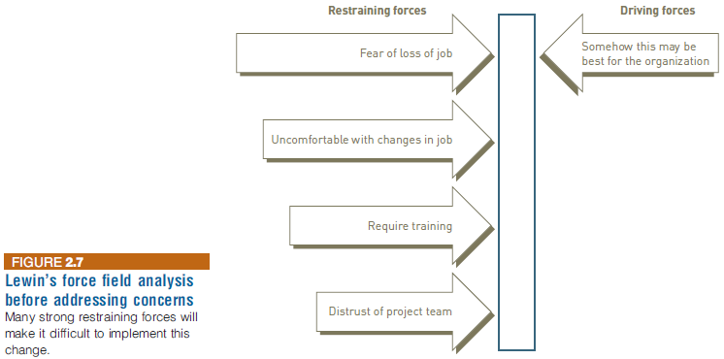
Lewin’s Force Field Analysis
Notes:
Lewin’s Force Field Analysis

Slide 22
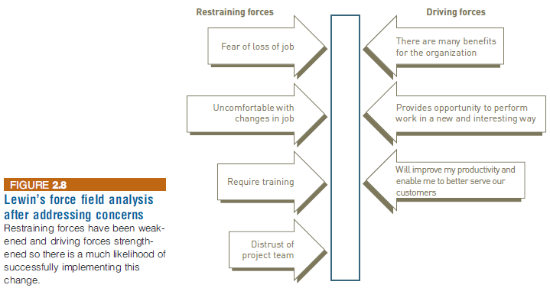
Lewin’s Force Field Analysis
Notes:
Lewin’s Force Field Analysis

Slide 23
Leavitt’s Diamond
A theory that proposes that every organizational system is made up of four main components—people, tasks, structure, and technology—with an interaction among the four components
Any change in one of these elements will necessitate a change in the other three elements
Organizational learning
The adaptations and adjustments based on experience and ideas over time
Adjustments can require reengineering or can result from continuous improvement
Notes:
Leavitt’s Diamond
A theory that proposes that every organizational system is made up of four main components—people, tasks, structure, and technology—with an interaction among the four components
Any change in one of these elements will necessitate a change in the other three elements
Organizational learning
The adaptations and adjustments based on experience and ideas over time
Adjustments can require reengineering or can result from continuous improvement

Slide 24
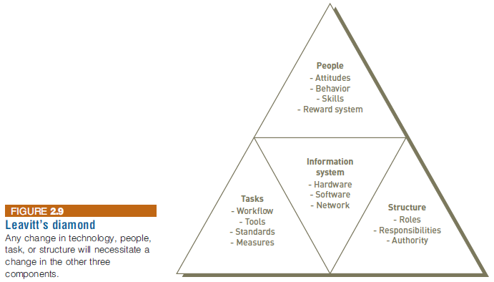
Leavitt’s Diamond
Notes:
Leavitt’s Diamond

Slide 25
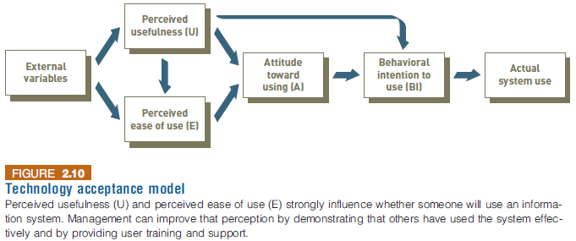
User Satisfaction and Technology Acceptance
Technology acceptance model (TAM)
Specifies the factors that can lead to better attitudes about the information system
Notes:
User Satisfaction and Technology Acceptance
Technology acceptance model (TAM)
Specifies the factors that can lead to better attitudes about the information system

Slide 26
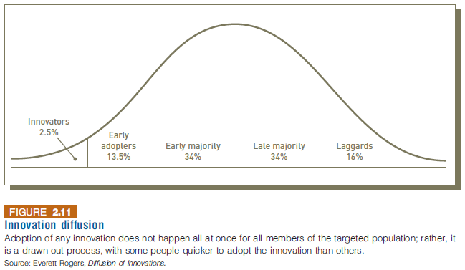
Diffusion of Innovation Theory
A theory developed by E.M. Rogers
Explains how a new idea or product gains acceptance and diffuses (or spreads) through a specific population or subset of an organization
Notes:
Diffusion of Innovation Theory
A theory developed by E.M. Rogers
Explains how a new idea or product gains acceptance and diffuses (or spreads) through a specific population or subset of an organization

Slide 27
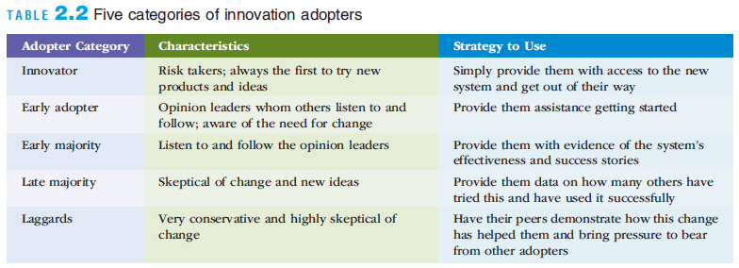
Diffusion of Innovation Theory
Notes:
Diffusion of Innovation Theory

Slide 28
Careers in Information Systems
Successful IS workers must:
Enjoy working in a fast-paced, dynamic environment
Meet deadlines and solving unexpected challenges
Possess good communication skills
Have solid analytical and decision-making skills
Develop effective team and leadership skills
Be adept at implementing organization change
Be prepared to engage in life-long learning in a rapidly changing field
Notes:
Careers in Information Systems
Successful IS workers must:
Enjoy working in a fast-paced, dynamic environment
Meet deadlines and solving unexpected challenges
Possess good communication skills
Have solid analytical and decision-making skills
Develop effective team and leadership skills
Be adept at implementing organization change
Be prepared to engage in life-long learning in a rapidly changing field

Slide 29
Careers in Information Systems
Technical skills important for IS workers to have:
Capability to analyze large amounts of structured and unstructured data
Ability to design/build applications for mobile devices
Programing and application development skills
Technical support expertise
Project management skills
Knowledge of networking and cloud computing
Ability to audit systems and implement necessary security measures
Notes:
Careers in Information Systems
Technical skills important for IS workers to have:
Capability to analyze large amounts of structured and unstructured data
Ability to design/build applications for mobile devices
Programing and application development skills
Technical support expertise
Project management skills
Knowledge of networking and cloud computing
Ability to audit systems and implement necessary security measures

Slide 30
Careers in Information Systems
Technical skills important for IS workers to have (cont’d):
Web design and development skills
Knowledge of data center operations
The U.S. Bureau of Labor Statistics (BLS) forecasts an increase of 1.2 million new computing jobs between 2012-2022
Notes:
Careers in Information Systems
Technical skills important for IS workers to have (cont’d):
Web design and development skills
Knowledge of data center operations
The U.S. Bureau of Labor Statistics (BLS) forecasts an increase of 1.2 million new computing jobs between 2012-2022

Slide 31
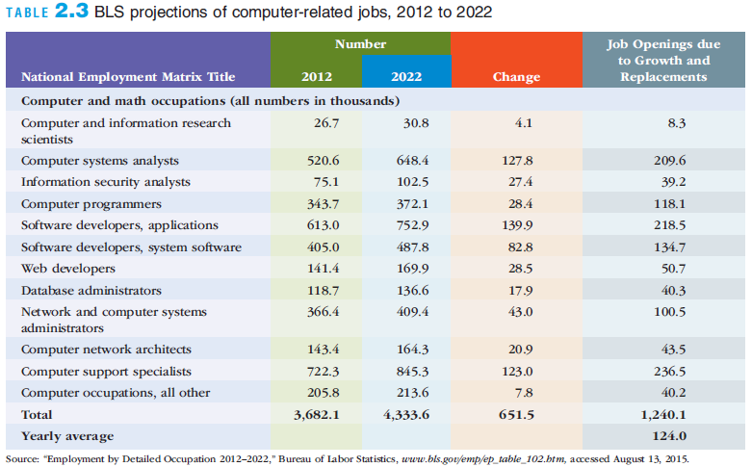
Careers in Information Systems
Notes:
Careers in Information Systems

Slide 32
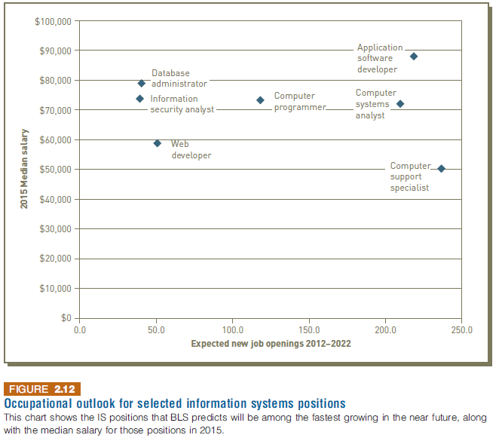
Careers in Information Systems
Notes:
Careers in Information Systems

Slide 33
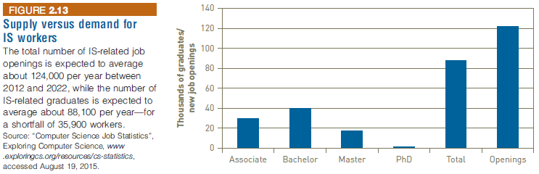
Careers in Information Systems
Notes:
Careers in Information Systems

Slide 34
Careers in Information Systems
U.S. H-1B and L-1 visa programs seek to allow skilled employees from foreign lands into the United States
Programs are limited and are high demand
L-1 visa program is often used for intracompany transfers for multinational companies
H-1B program can be used for new employees
Notes:
Careers in Information Systems
U.S. H-1B and L-1 visa programs seek to allow skilled employees from foreign lands into the United States
Programs are limited and are high demand
L-1 visa program is often used for intracompany transfers for multinational companies
H-1B program can be used for new employees

Slide 35
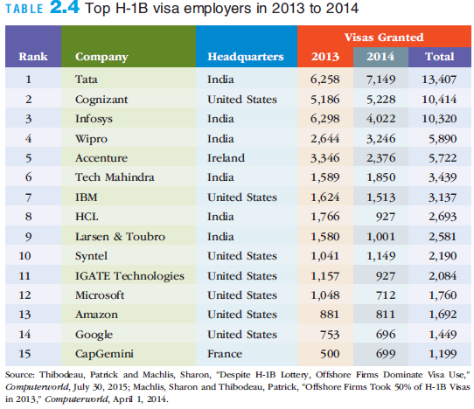
Careers in Information Systems
Notes:
Careers in Information Systems

Slide 36
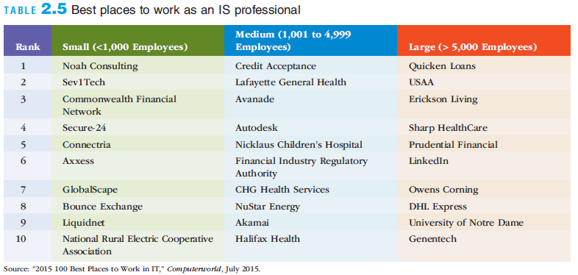
Careers in Information Systems
Notes:
Careers in Information Systems

Slide 37
Roles, Functions, and Careers in IS
In addition to technical skills, IS professionals need:
Skills in written and verbal communication
An understanding of organizations and the way they operate
The ability to work with people and in groups
Notes:
Roles, Functions, and Careers in IS
In addition to technical skills, IS professionals need:
Skills in written and verbal communication
An understanding of organizations and the way they operate
The ability to work with people and in groups

Slide 38
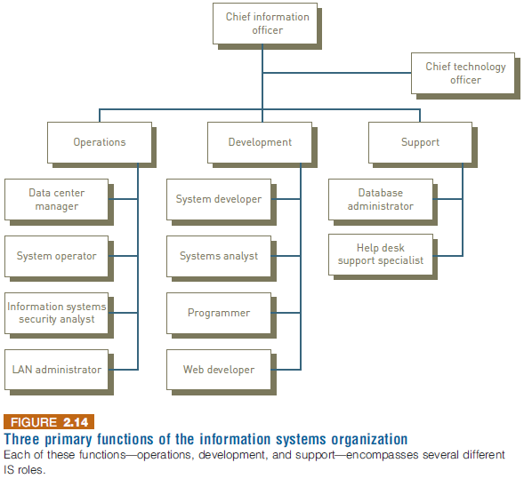
Roles, Functions, and Careers in IS
Notes:
Roles, Functions, and Careers in IS

Slide 39
Typical IS Titles and Functions
Chief information officer (CIO) employs the IS department’s equipment and personnel to help the organization attain its goals
Senior IS Managers
Vice president of information systems
Manager of information systems
Chief technology officer (CTO)
Central role of all of the above is to communicate with other areas of the organization to determine changing business needs
Notes:
Typical IS Titles and Functions
Chief information officer (CIO) employs the IS department’s equipment and personnel to help the organization attain its goals
Senior IS Managers
Vice president of information systems
Manager of information systems
Chief technology officer (CTO)
Central role of all of the above is to communicate with other areas of the organization to determine changing business needs

Slide 40
Typical IS Titles and Functions: Operations Roles
Data center managers are responsible for the maintenance and operation of the organization’s computing facilities
System operators run and maintain IS equipment
IS security analysts are responsible for maintaining the security and integrity of their organizations’ systems and data
Local area network (LAN) administrators set up and manage the network hardware, software, and security processes
Notes:
Typical IS Titles and Functions: Operations Roles
Data center managers are responsible for the maintenance and operation of the organization’s computing facilities
System operators run and maintain IS equipment
IS security analysts are responsible for maintaining the security and integrity of their organizations’ systems and data
Local area network (LAN) administrators set up and manage the network hardware, software, and security processes

Slide 41
Typical IS Titles and Functions: Development Roles
Software developers write the software that customers and employees use
Systems analysts consult with management and users, as well as convey system requirements to software developers and network architects
Programmers convert a program design developed by a systems analyst or software developer into one of many computer languages
Web developers design and maintain Web sites, including site layout and function, to meet the client’s requirements
Notes:
Typical IS Titles and Functions: Development Roles
Software developers write the software that customers and employees use
Systems analysts consult with management and users, as well as convey system requirements to software developers and network architects
Programmers convert a program design developed by a systems analyst or software developer into one of many computer languages
Web developers design and maintain Web sites, including site layout and function, to meet the client’s requirements

Slide 42
Typical IS Titles and Functions: Support
Database administrators (DBAs) design and set up databases to meet an organization’s needs
System support specialists respond to telephone calls, email, and other inquiries from computer users
Notes:
Typical IS Titles and Functions: Support
Database administrators (DBAs) design and set up databases to meet an organization’s needs
System support specialists respond to telephone calls, email, and other inquiries from computer users

Slide 43
IS-Related Roles outside the IS Organization
Shadow IT
A term used to describe the IS and solutions built and deployed by departments other than the information systems department
Enables business managers to quickly create highly innovative solutions to real business problems and to test these solutions out
Notes:
IS-Related Roles outside the IS Organization
Shadow IT
A term used to describe the IS and solutions built and deployed by departments other than the information systems department
Enables business managers to quickly create highly innovative solutions to real business problems and to test these solutions out

Slide 44
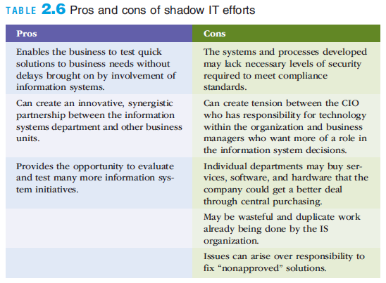
IS-Related Roles outside the IS Organization
Notes:
IS-Related Roles outside the IS Organization

Slide 45
Certification
Certification
A process for testing skills and knowledge
Results in a statement by the certifying authority that confirms an individual is capable of performing particular tasks
Frequently involves specific, vendor-provided or vendor-endorsed coursework
Notes:
Certification
Certification
A process for testing skills and knowledge
Results in a statement by the certifying authority that confirms an individual is capable of performing particular tasks
Frequently involves specific, vendor-provided or vendor-endorsed coursework

Slide 46
Other IS Careers
Consulting opportunities
Computer training
Computer and computer-equipment sales
Computer repair and maintenance
Support services
Employment with technology companies
Entrepreneurial ventures
Notes:
Other IS Careers
Consulting opportunities
Computer training
Computer and computer-equipment sales
Computer repair and maintenance
Support services
Employment with technology companies
Entrepreneurial ventures

Slide 47
Working in Teams
Most IS careers involve working in project teams that can consist of many of the positions and roles
It is always good for IS professionals to:
Have good communications skills and the ability to work with other people
Notes:
Working in Teams
Most IS careers involve working in project teams that can consist of many of the positions and roles
It is always good for IS professionals to:
Have good communications skills and the ability to work with other people

Slide 48
Finding a Job in IS
Developing an online résumé can be critical to finding a good job
The Internet
Online job sites
Company Web sites
Social networking sites
Informal networks of colleagues or business acquaintances
Notes:
Finding a Job in IS
Developing an online résumé can be critical to finding a good job
The Internet
Online job sites
Company Web sites
Social networking sites
Informal networks of colleagues or business acquaintances

Slide 49
Summary
Organizations are open systems that affect and are affected by their surrounding environment
Positive change is a key ingredient for any successful organization
Information systems must be implemented in such a manner that they are accepted and work well within the context of an organization and support its fundamental business goals and strategies
The information system worker functions at the intersection of business and technology and designs, builds, and implements solutions that allow organizations to effectively leverage information technology systems
Notes:
Summary
Organizations are open systems that affect and are affected by their surrounding environment
Positive change is a key ingredient for any successful organization
Information systems must be implemented in such a manner that they are accepted and work well within the context of an organization and support its fundamental business goals and strategies
The information system worker functions at the intersection of business and technology and designs, builds, and implements solutions that allow organizations to effectively leverage information technology systems

